Slide 1
SMART ROOM CONTROLLER
By
Rodney Ham

Slide 2
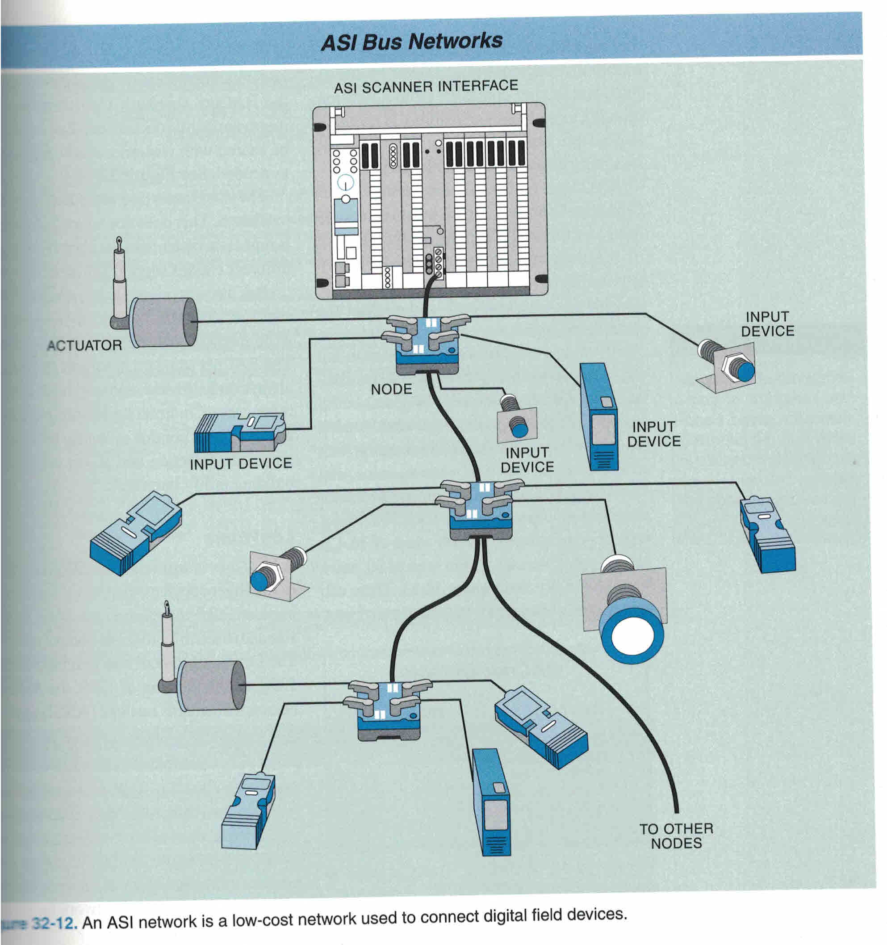
Notes:
Manufacturing process has many control devices.

Slide 3
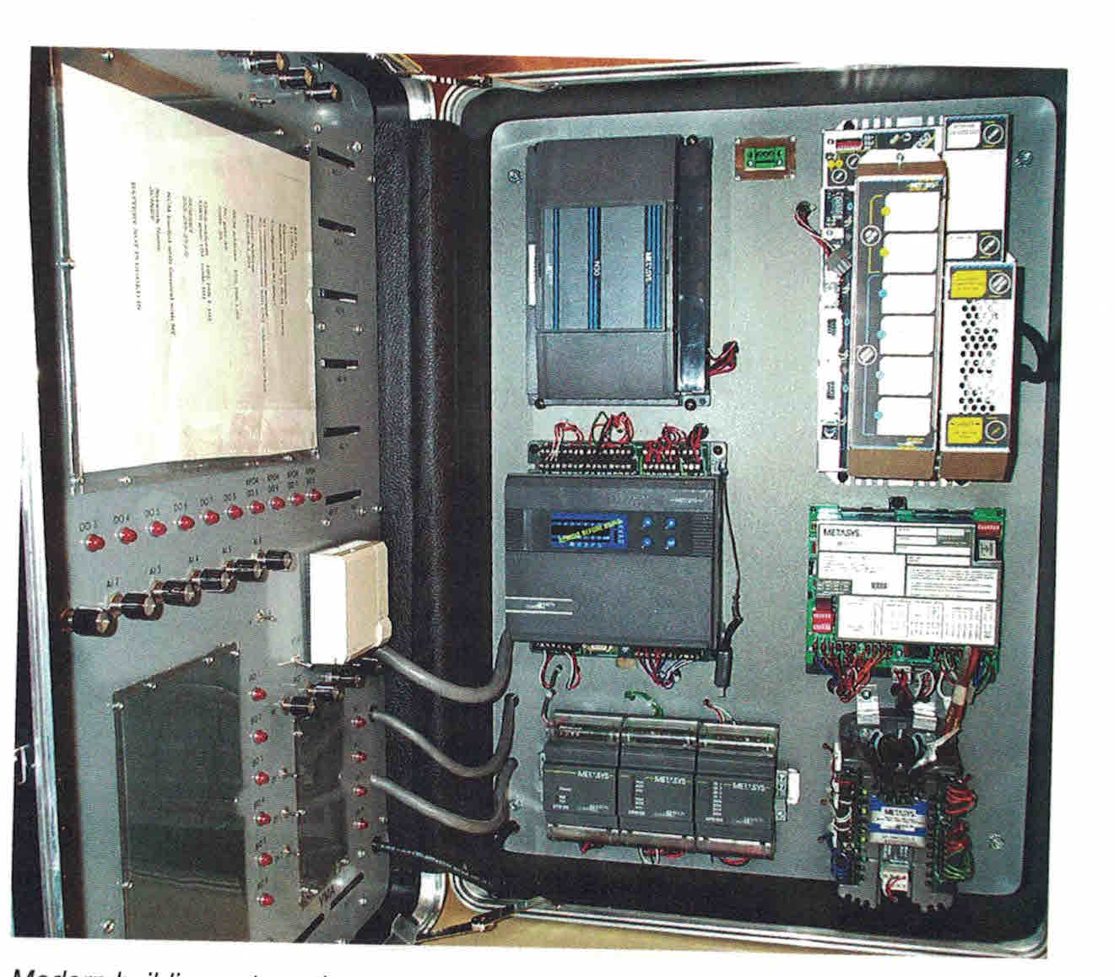
Notes:
Miles of wire connect devices to control panel. Problem: cracked/broken wires from friction resulting from conduit vibration; EMR exchange in conduit results in false readings; labor intensive to wire to floor of production equipment.

Slide 4
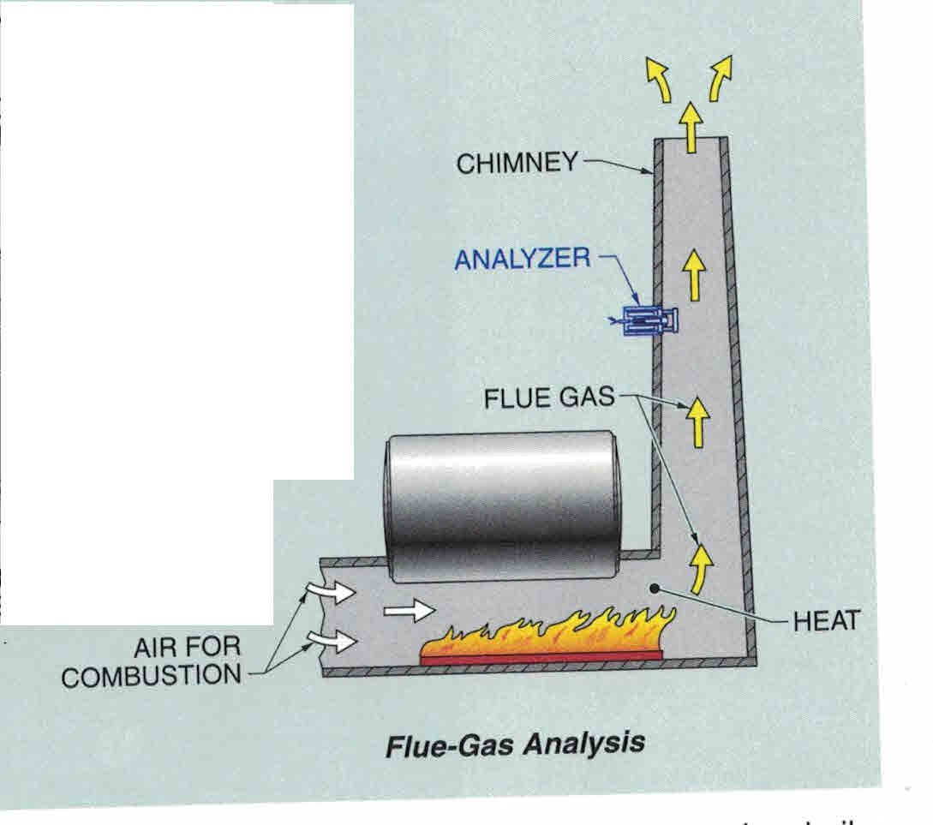
Notes:
Turn on flue fan to vent fumes

Slide 5
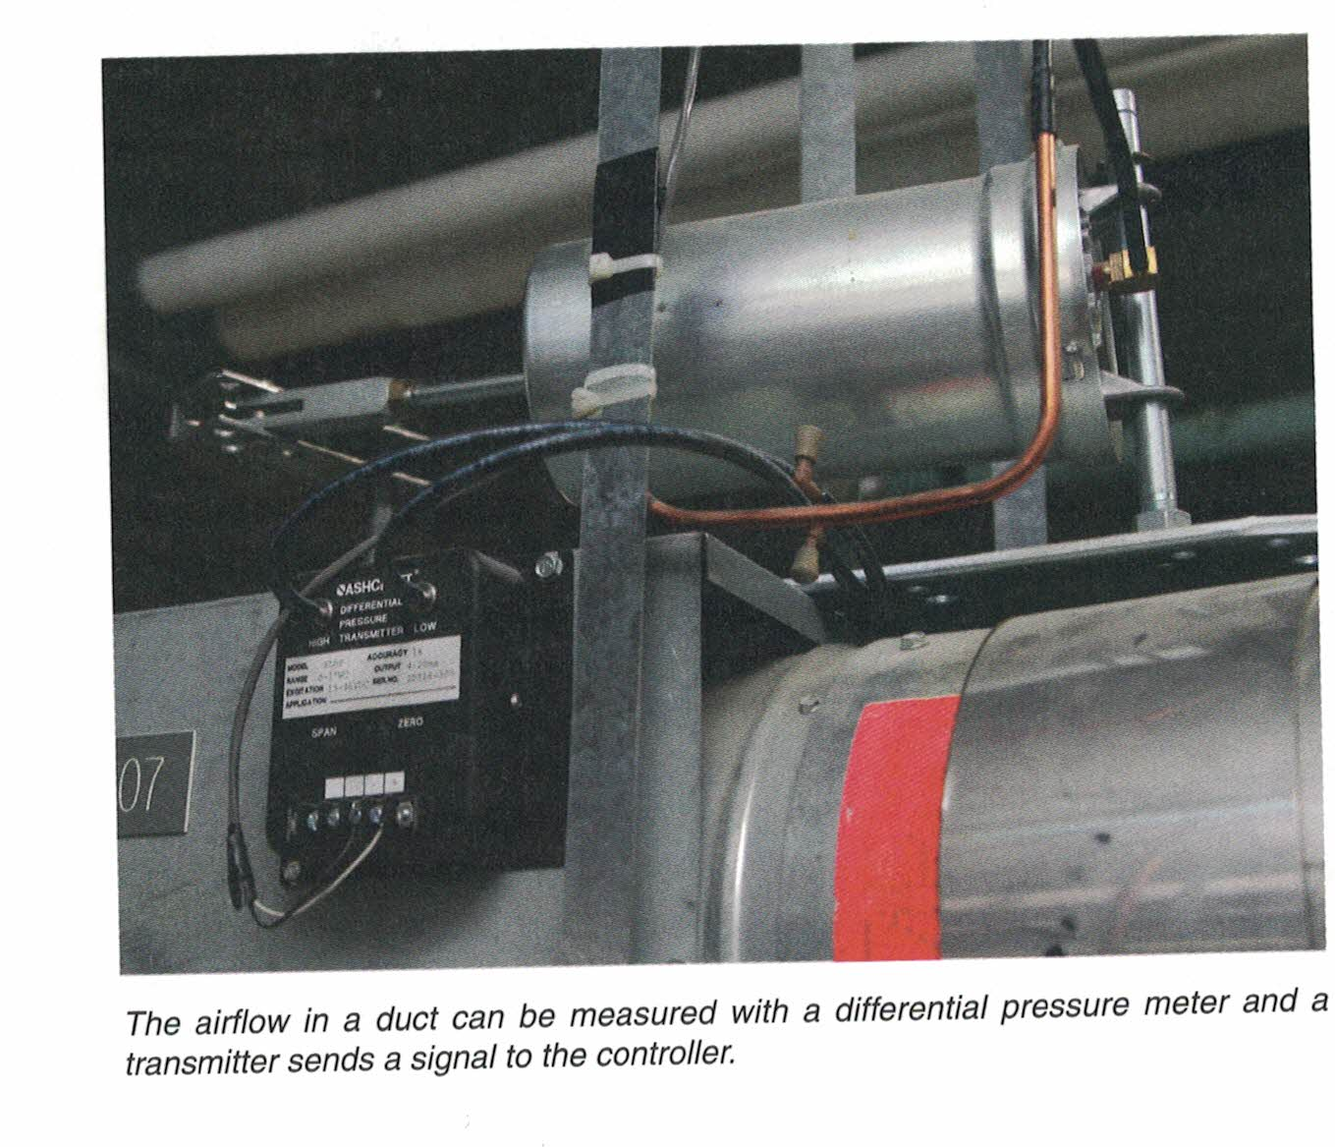
Notes:
Make sure there is no flue blockage by using a differential pressure meter

Slide 6
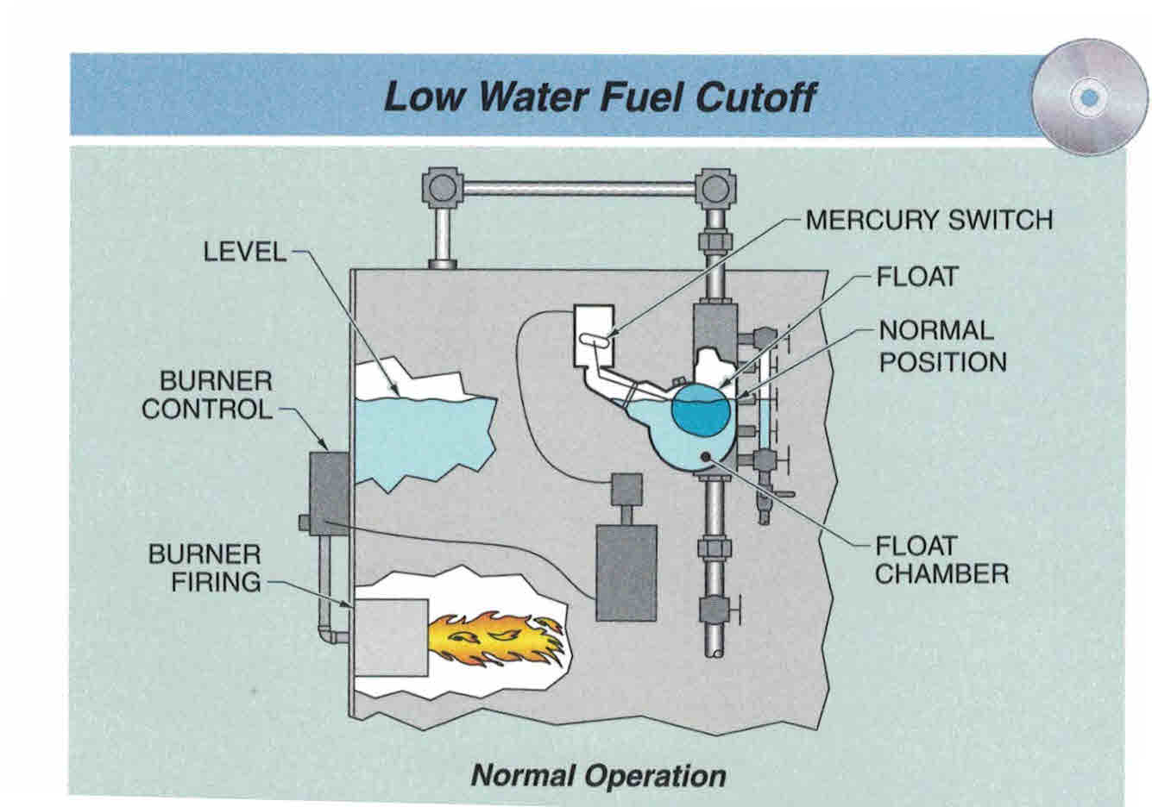
Notes:
Turn on water pump. Low water level shuts off burner. Quench products to proper temperature. Too hot of liquid results in improper hardening. Too cold causes fractures.

Slide 7
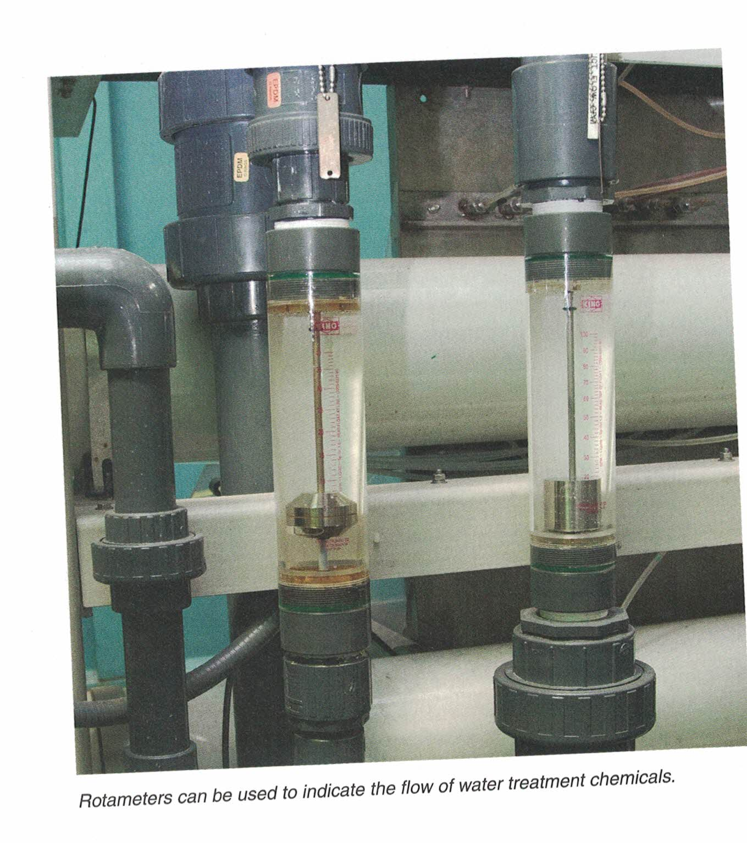
Notes:
Rotameter indicates visual of quench fluid flow.

Slide 8
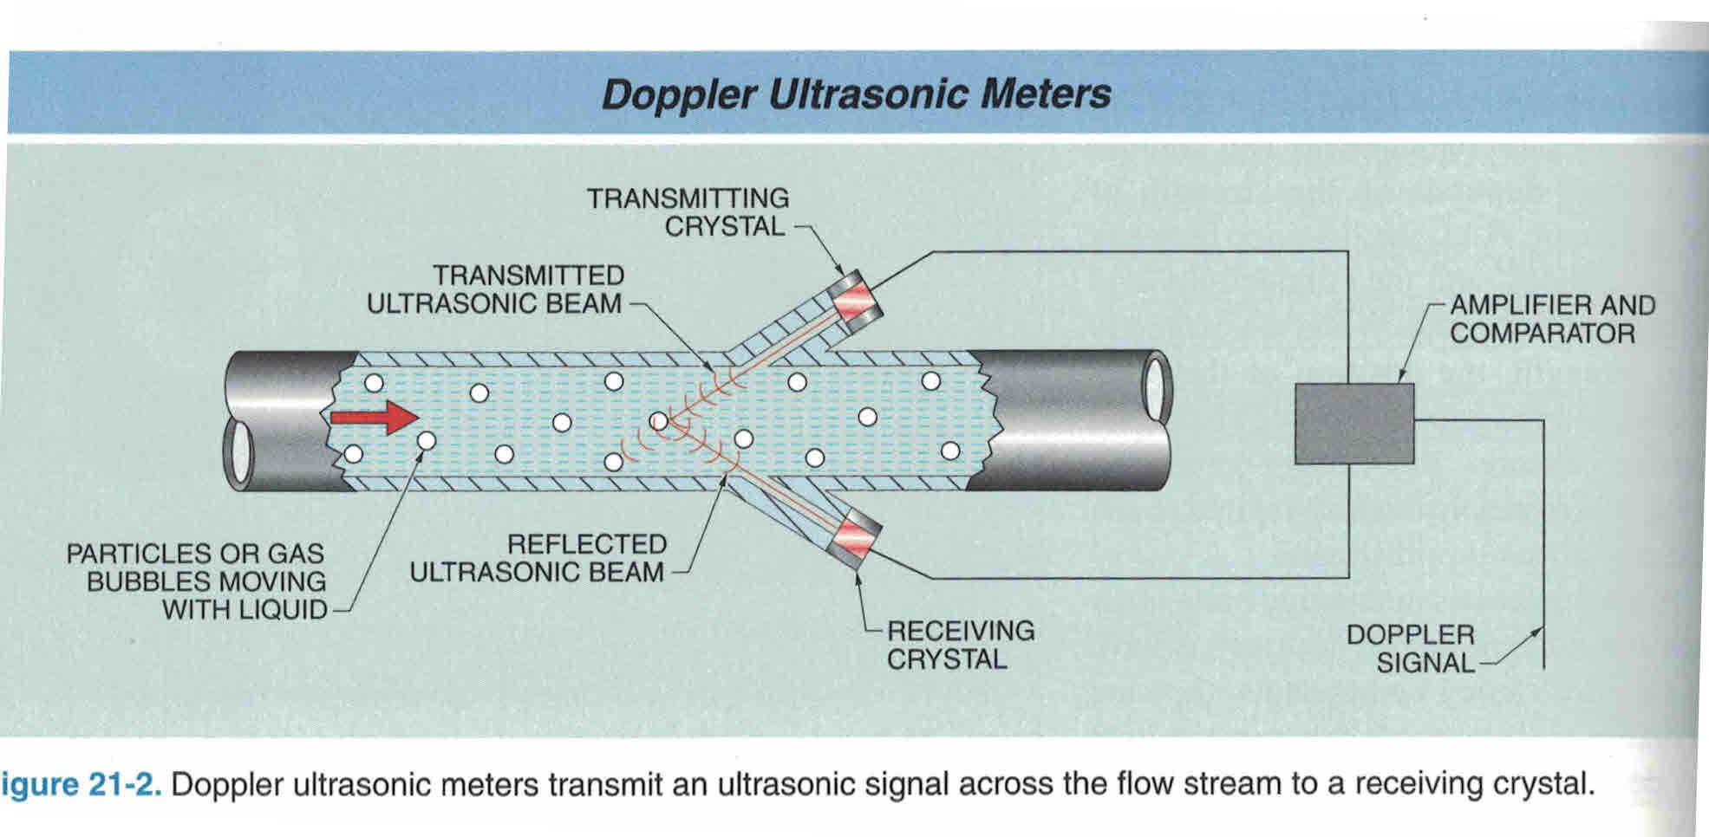
Notes:
Ultrasonic meter measures amount of doping in quenching fluid.

Slide 9
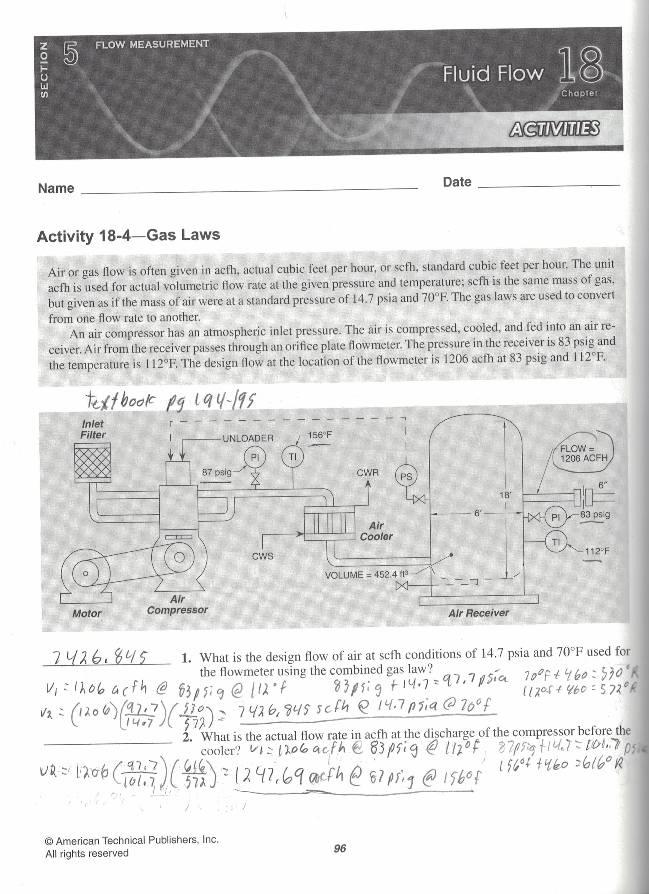
Notes:
Pump starts to pressurize the gas

Slide 10
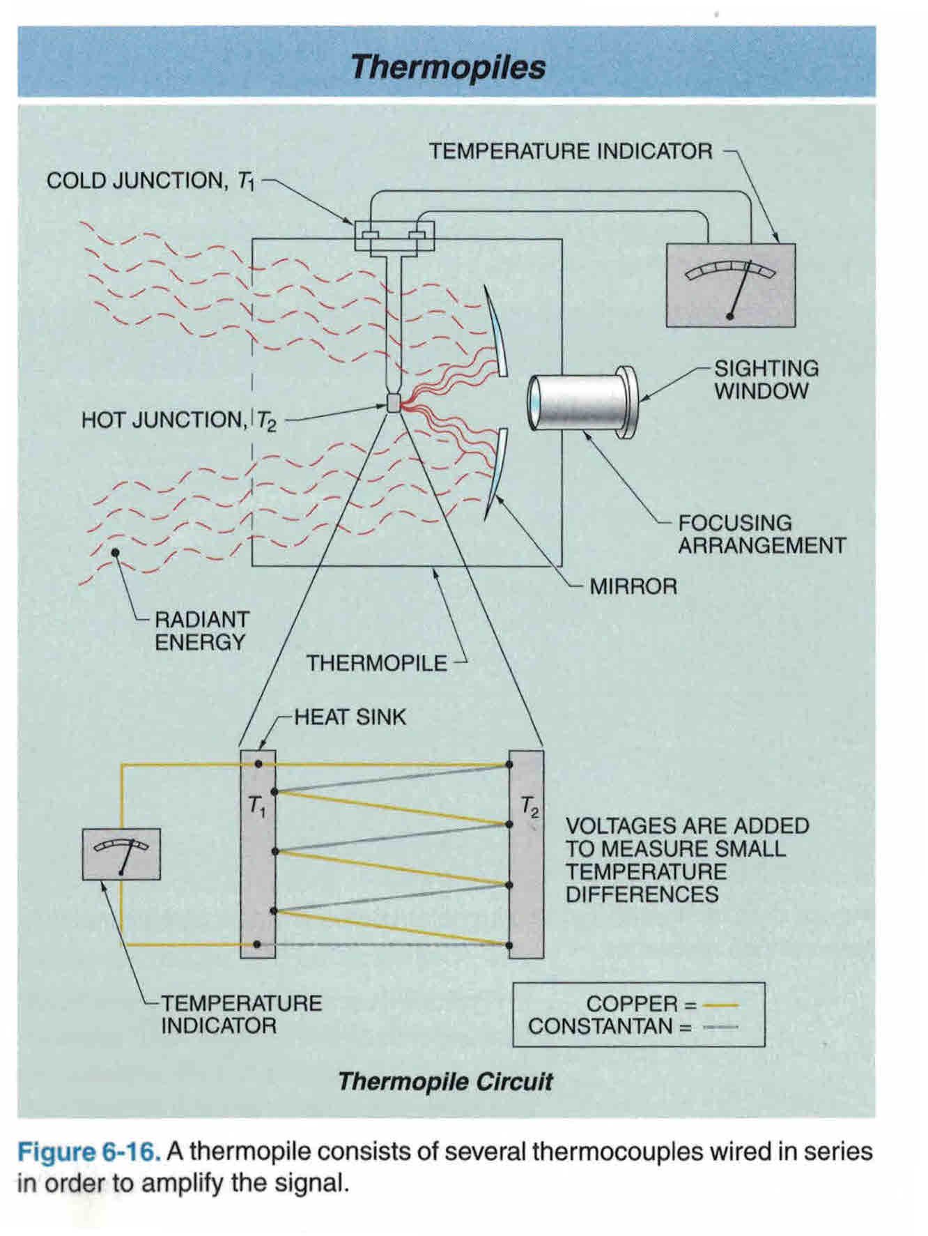
Notes:
Observe if furnace is at operating temperature

Slide 11
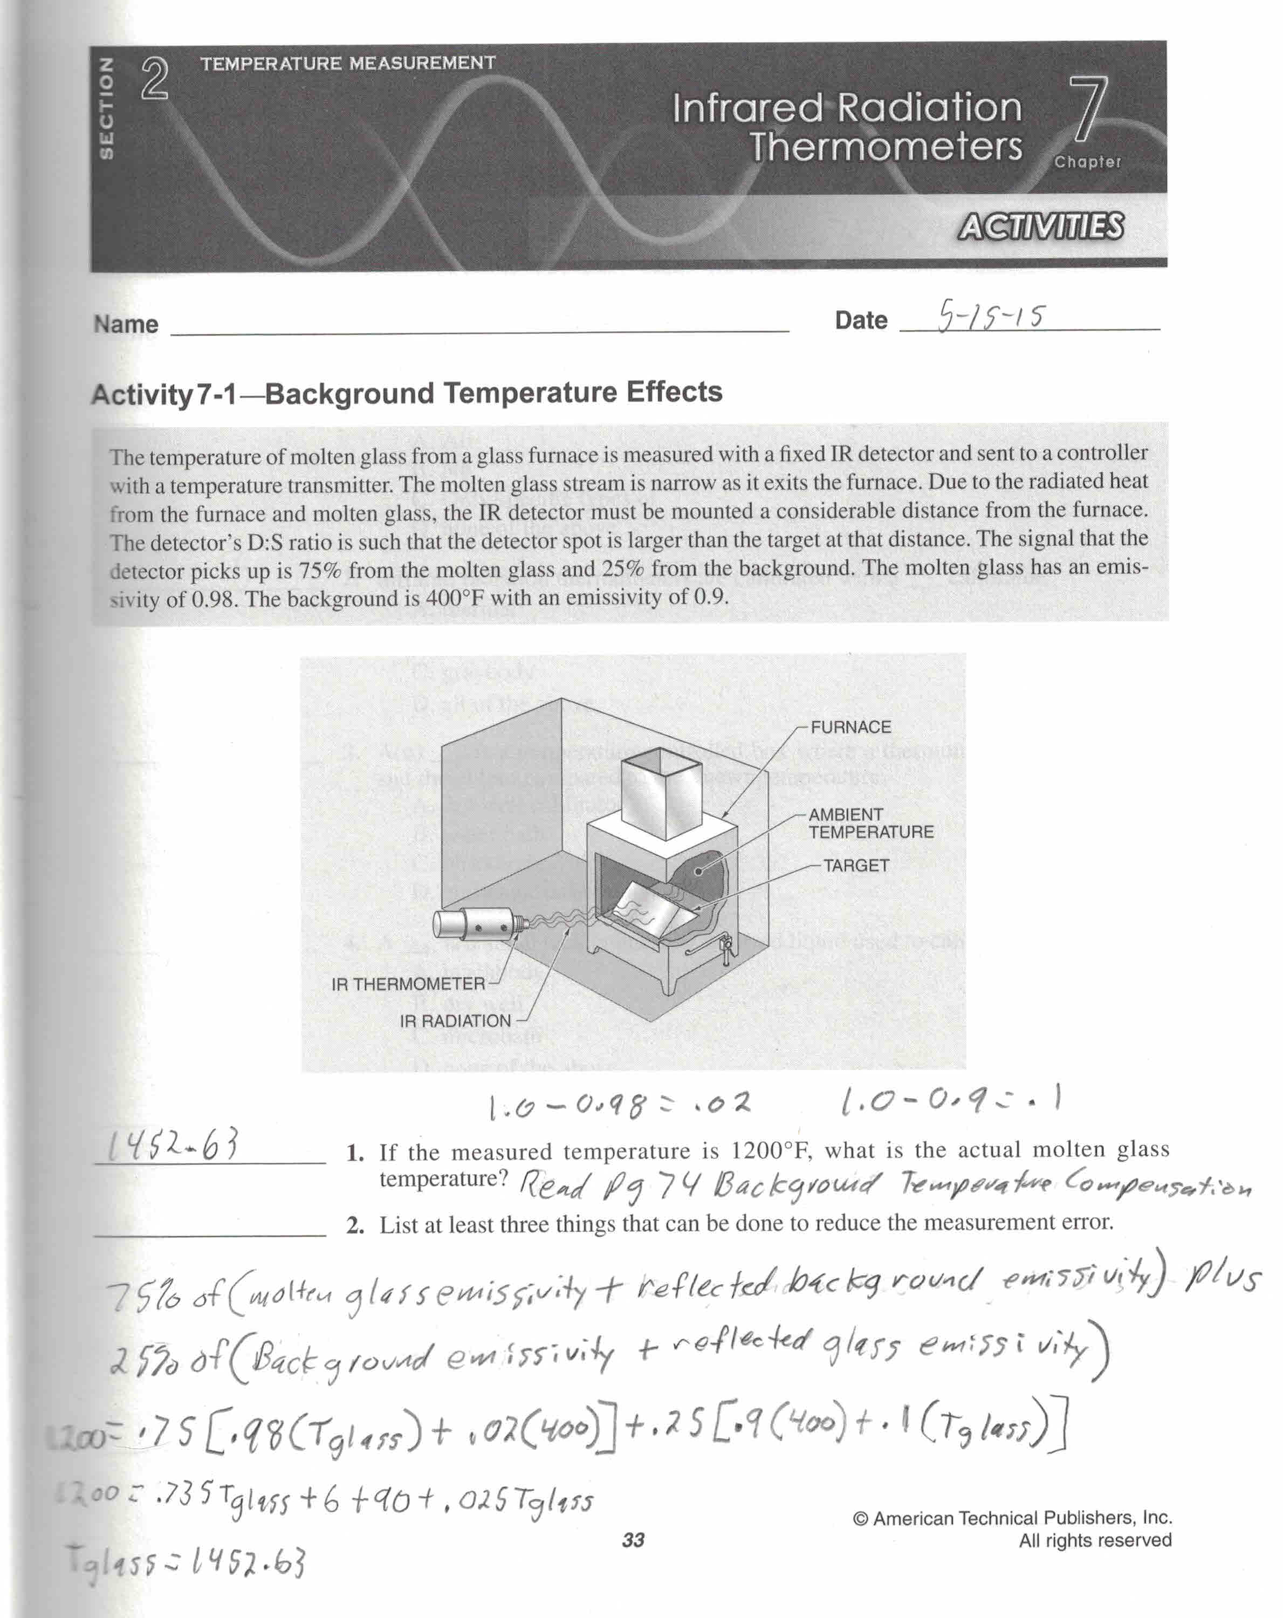
Notes:
Turn on IR detector for measuring temperature of molten material

Slide 12
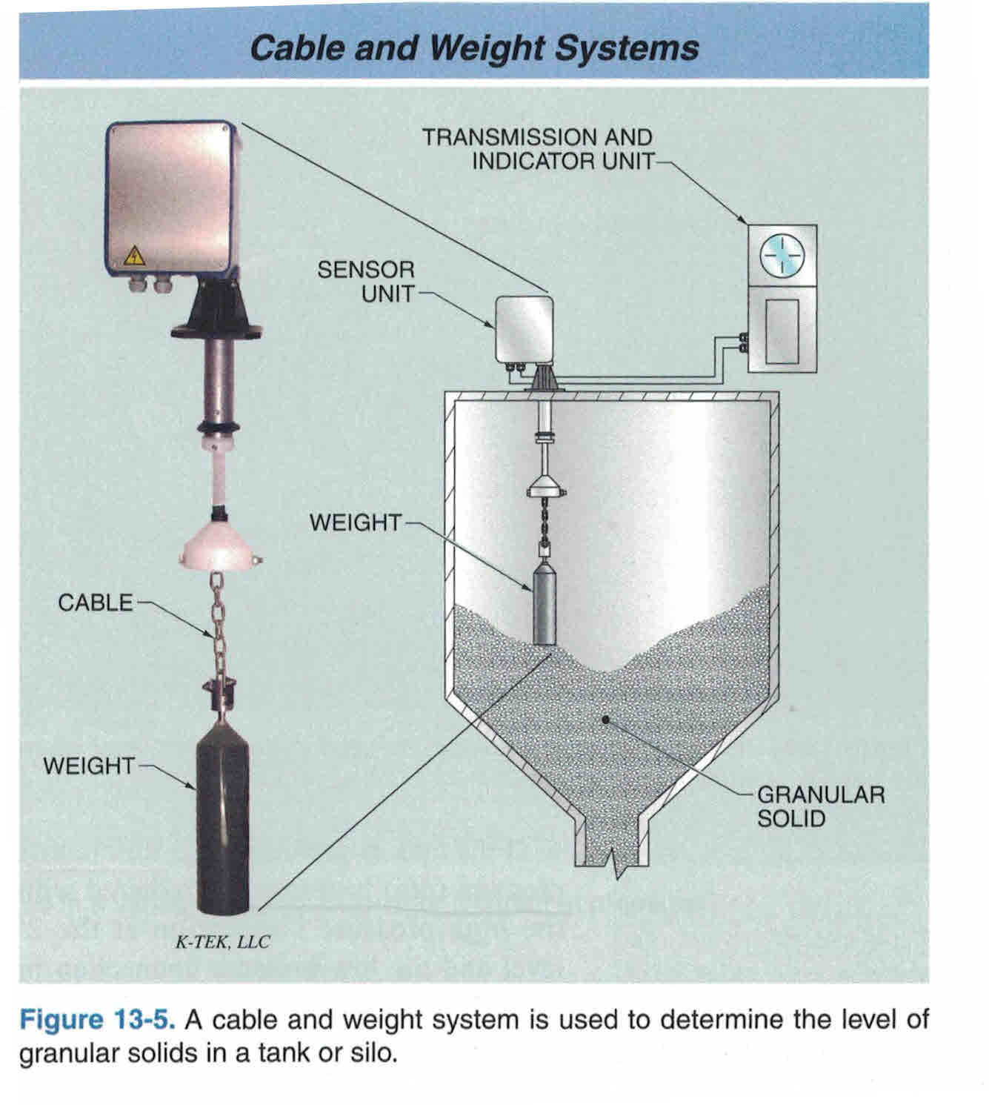
Notes:
Fill hopper if low.

Slide 13
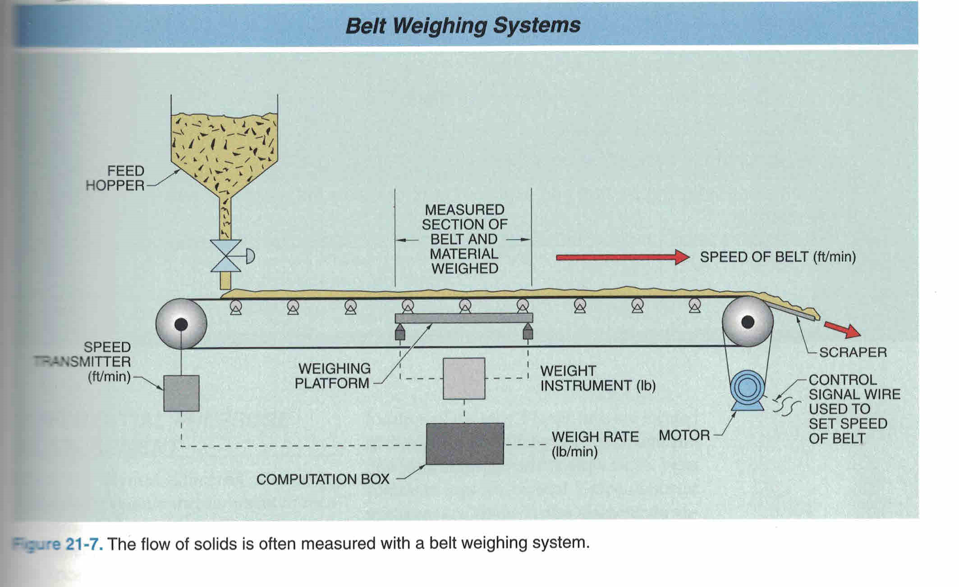
Notes:
Start conveyor.

Slide 14
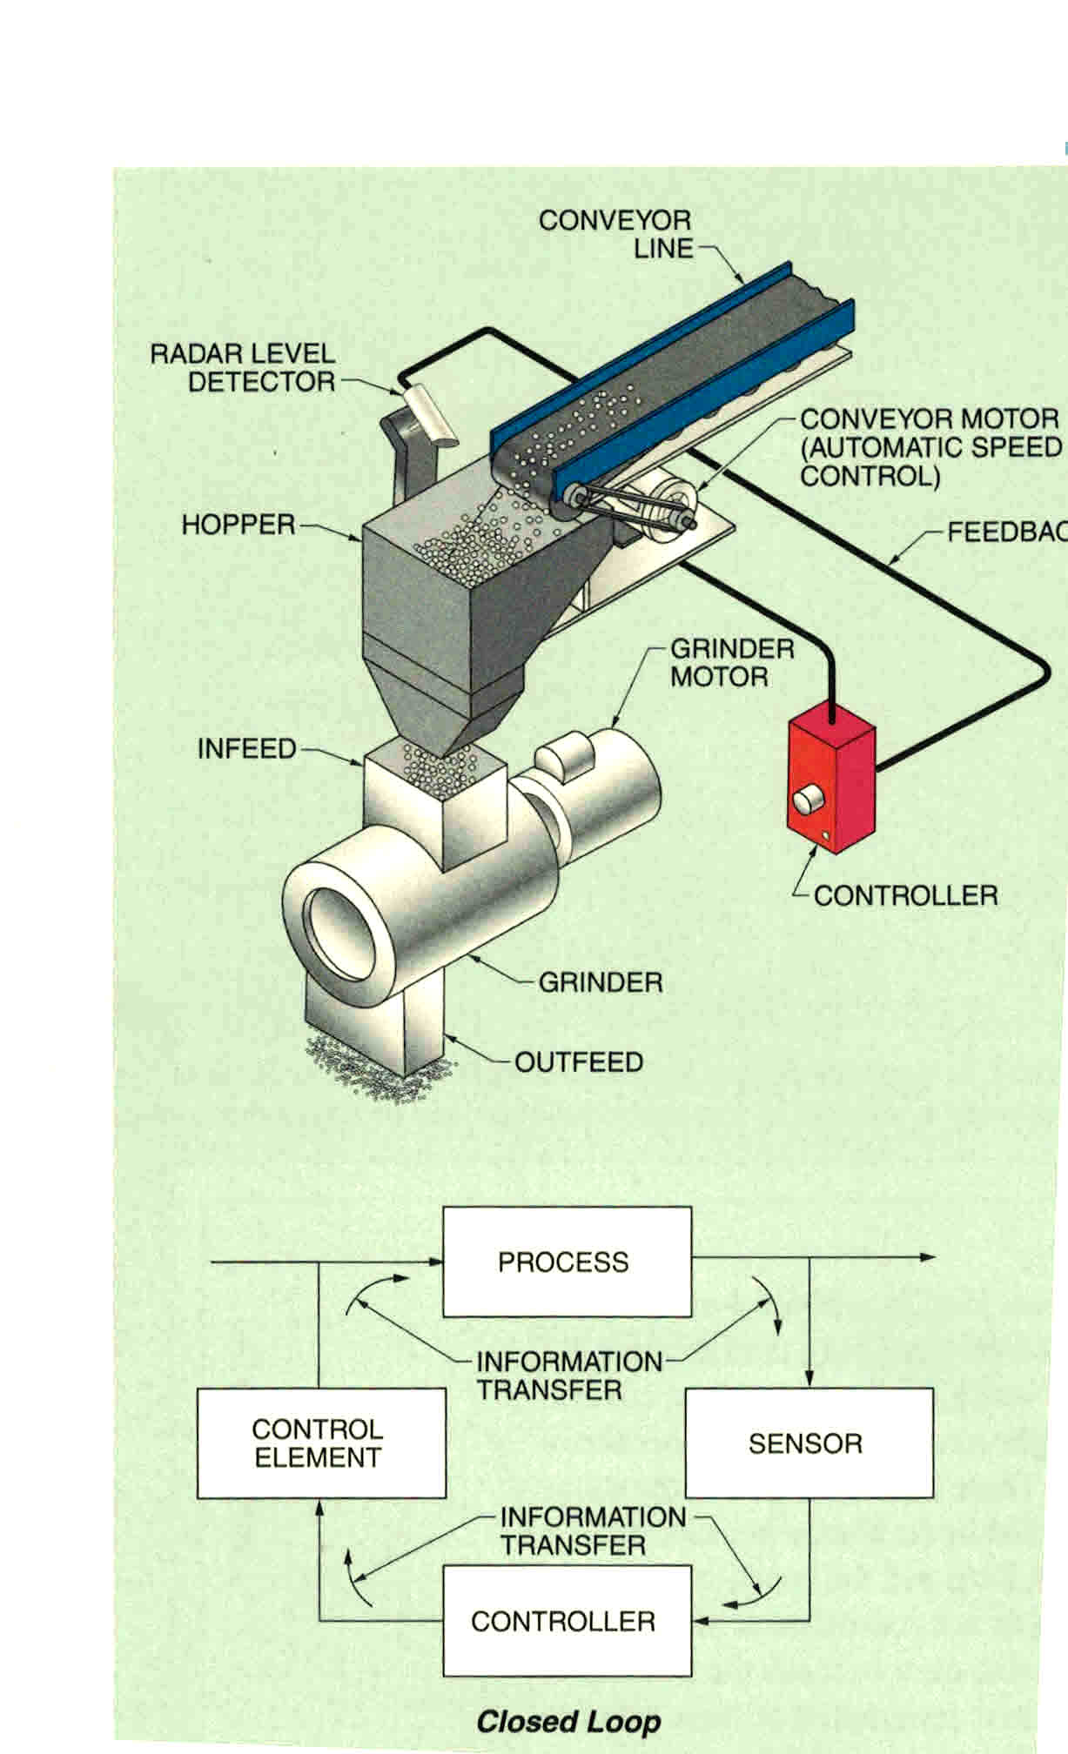
Notes:
If furnace is at operating temperature grind material & feed into molds.

Slide 15
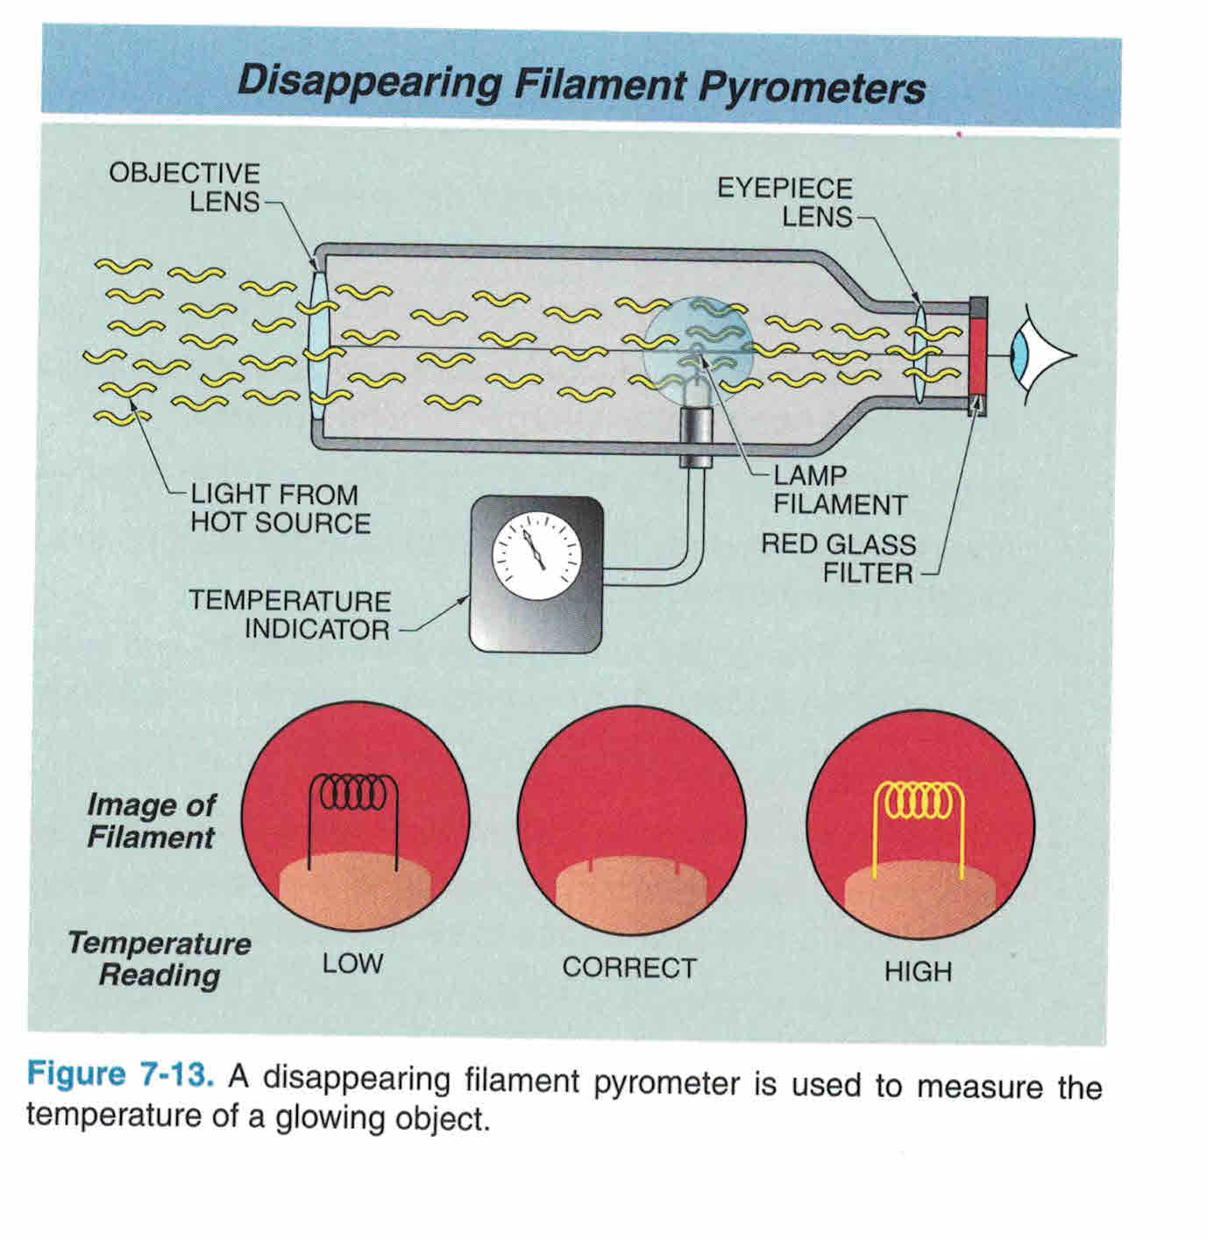
Notes:
Observe temperature of material leaving. Red led=too hot Clear led=desired range Blue led= material too cold.

Slide 16
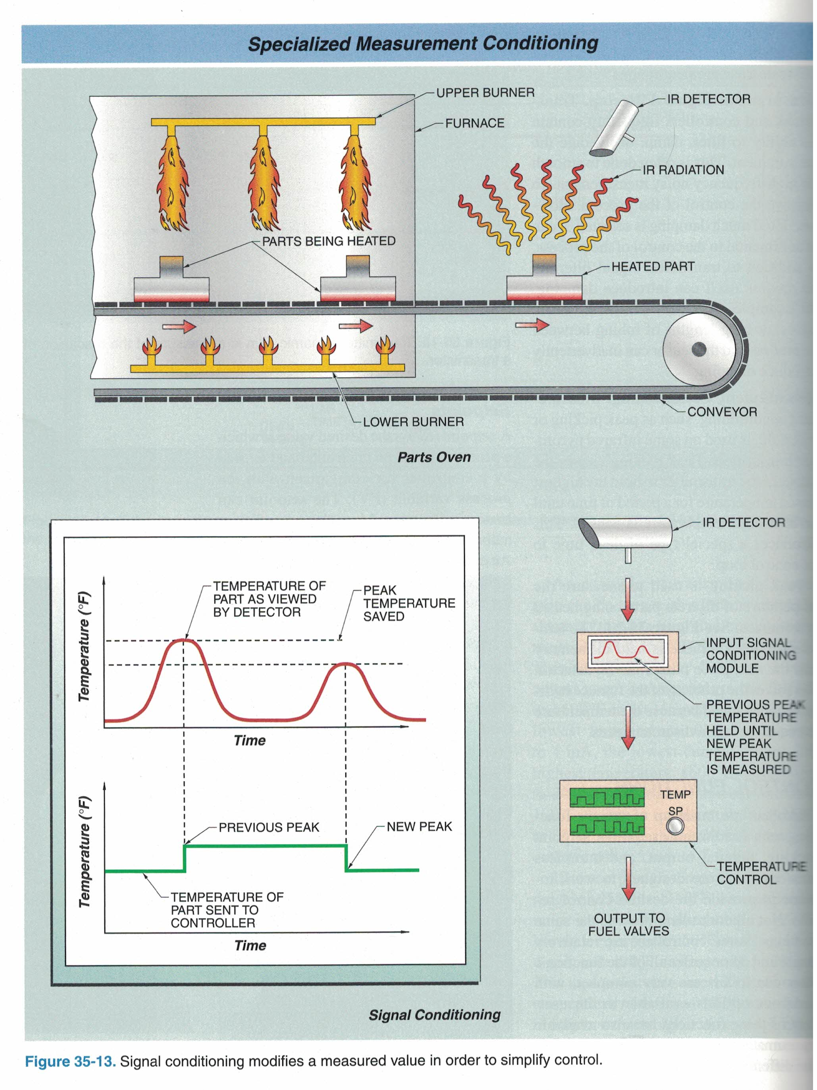
Notes:
Check IR radiation of material in mold as it travels to hammers and presses. Rainbow lights indicate material approaching IR detector, directly under detector, moving away from detector. Adjust detector sensitivity (brightness of lights)

Slide 17
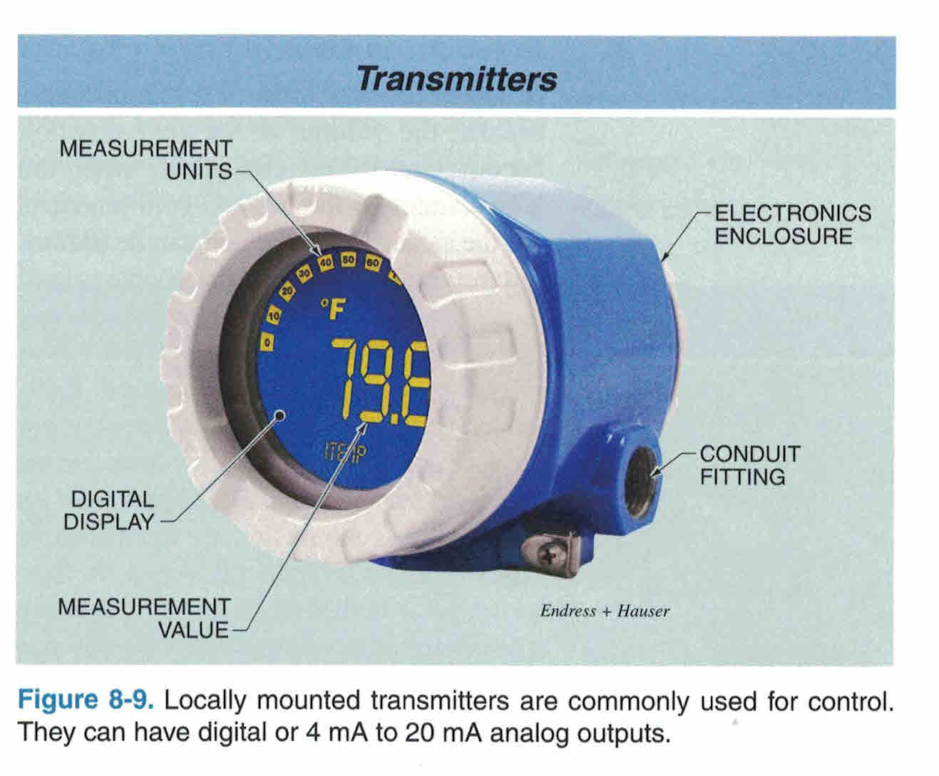
Notes:
Devices connected to internet via transmitters. No long wire runs.

Slide 18
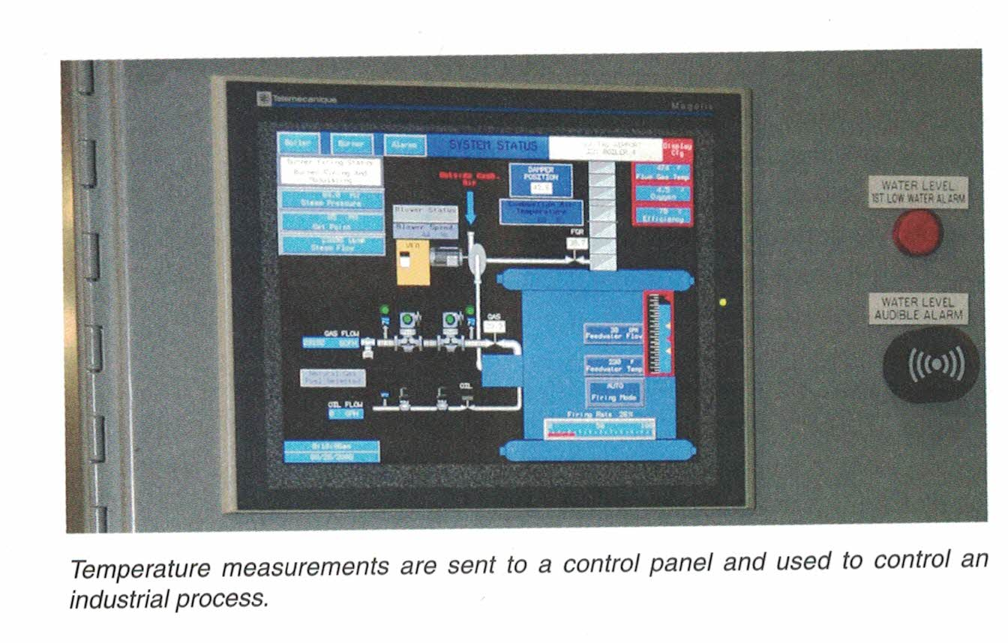
Notes:
Devices connected to control panel via internet.

Slide 19
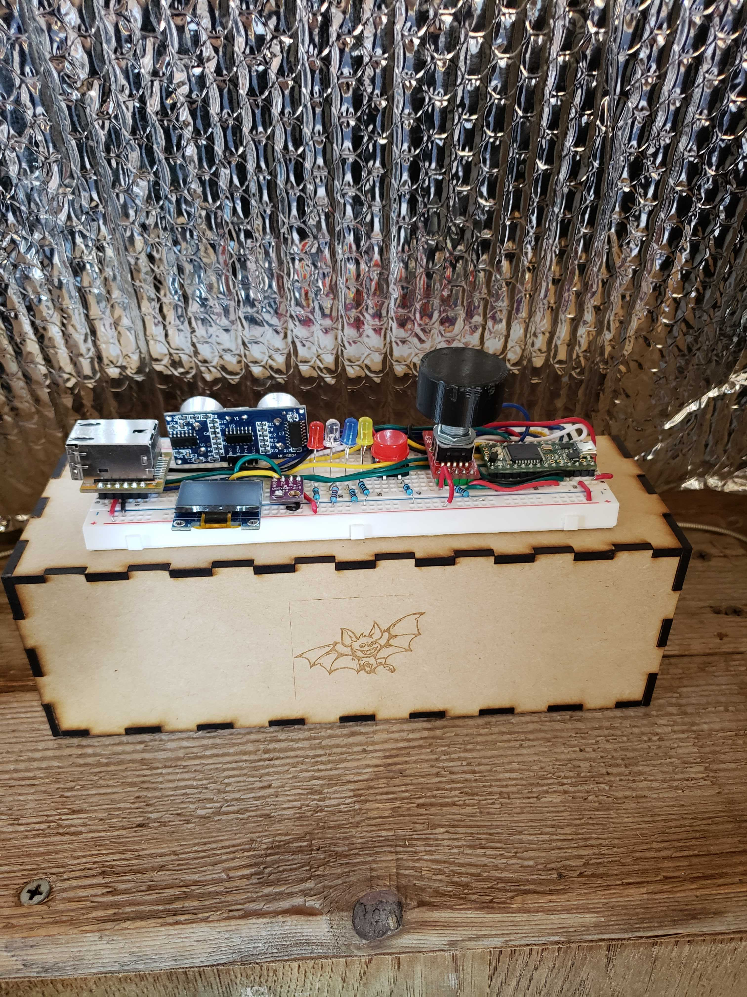
Notes:
Internet of Things controller simplifies the manufacturing line and increases production up time. No long wire runs. Less labor intensive. Fewer problems.

Slide 20
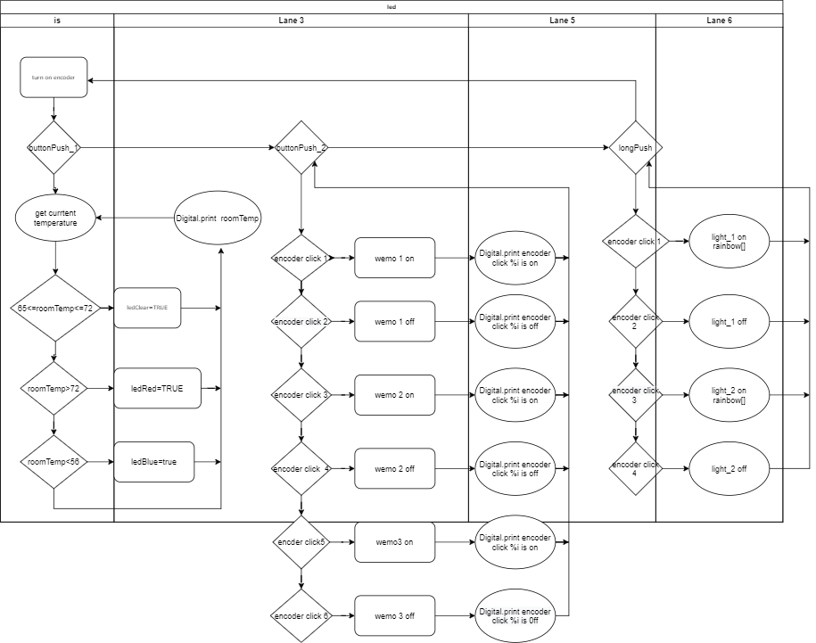

Slide 21
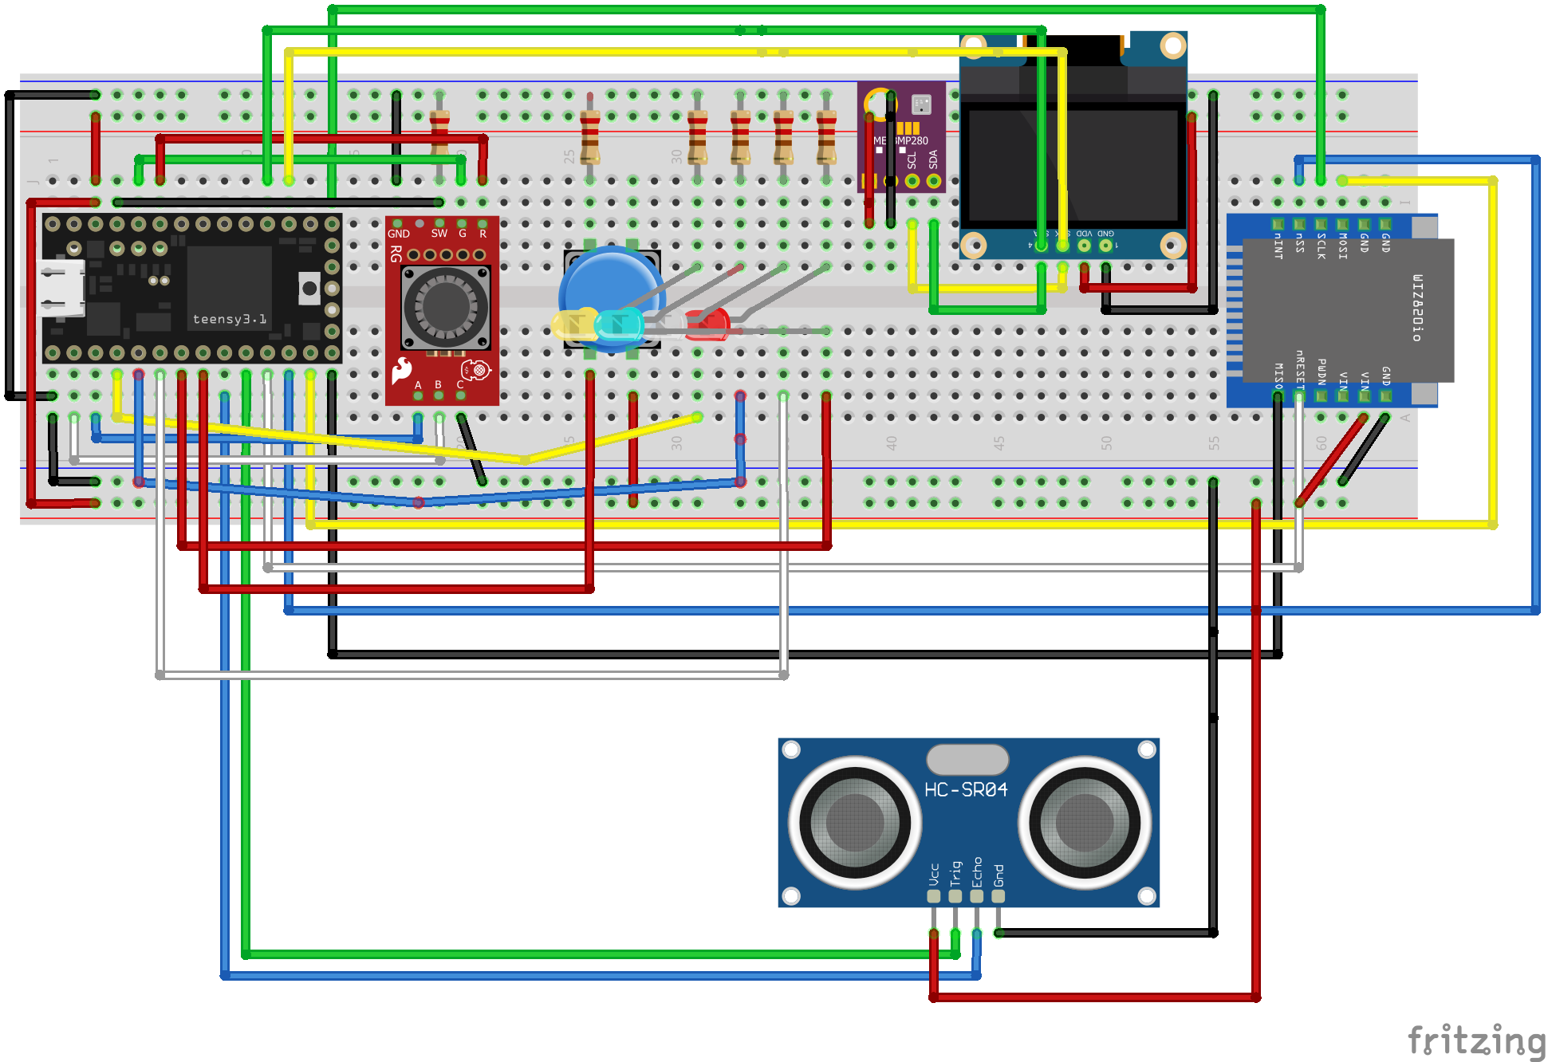

Slide 22


